Slide 1

CP5046 Group Presentation
Kindergarten Learning Game Design
Counting · Ordering · Comparison · Matching · Sorting
Assessment 3 · Professor Insu Song
Bohong Wang, Weichao Sun, Chen Xianzhe, Haoyang Liu

Slide 2
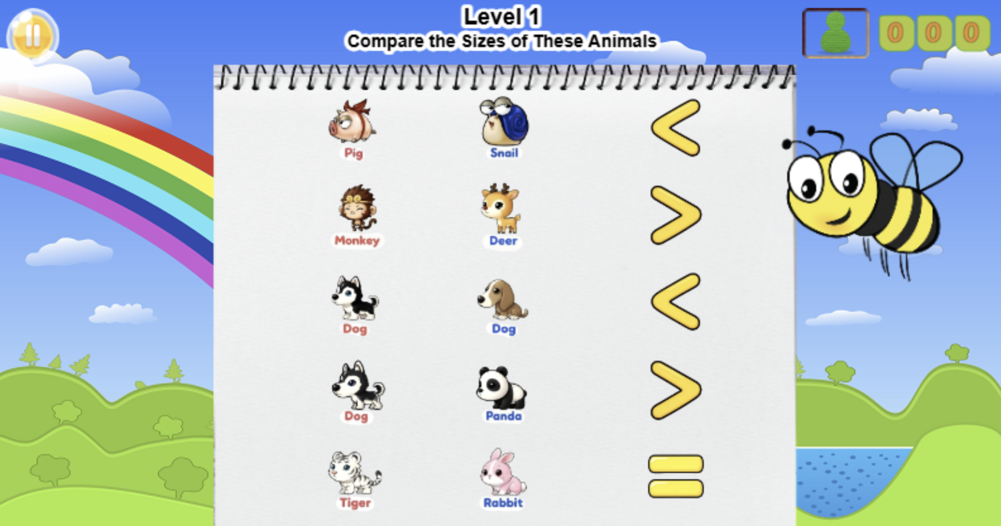






Team Charter
Team roles and the game themes each member contributed
SW
SW
Bohong Wang
Weichao Sun
Chen Xianzhe
Haoyang Liu
Game Designer / Scrum Coordinator
Team Leader / Game Designer
Designer / Tester
Game Designer / Scrum Coordinator
Math + ordering games
English comparison games
Music matching games
Art sorting games
• Fruit counting
• Animal ordering
• Vehicle ordering
• Animal size
• Item size
• Food size
• Musicians
• Instruments
• Jazz matching
• Colour sorting
• Start with a letter
• Categorise by colour
Shared FigJam project: https://www.figma.com/board/wcrZx8euXC17OJRNFkbkiT/2026-TR2-ICT1-Group-1

Slide 3
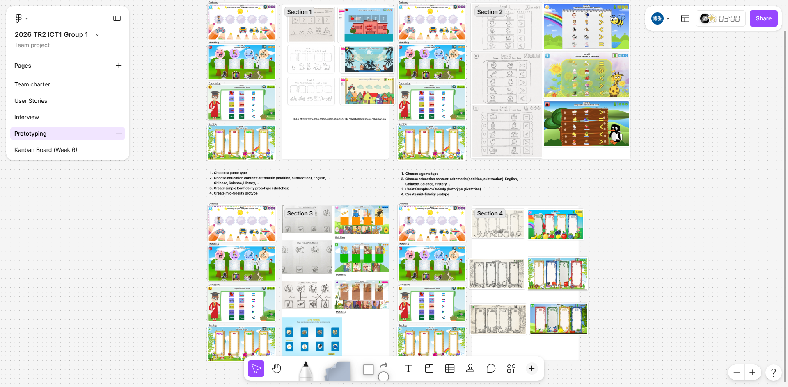
Project Goals
The goal was to design a small portfolio of child-friendly KOPO learning games
How we developed the goals
Team (4 members)
• Used user stories and team reviews to clarify learning needs
• Kept instructions short for kindergarten learners aged 4-6
• Selected familiar content: fruits, animals, vehicles, food, items, music and colours
• Used Figma / FigJam for planning and KOPO for prototype screens
↓
12 KOPO learning game levels
🍎 Counting
& ordering
🔎 Size
comparison
🎵 Music
matching
🎨 Colour
sorting
Specific design outcomes
• 12 prototype levels across four learning directions
• Large images, simple drag/drop or click interaction, and clear feedback
• Reusable screen structure to reduce confusion across levels
Figma / FigJam workspace evidence

Slide 4
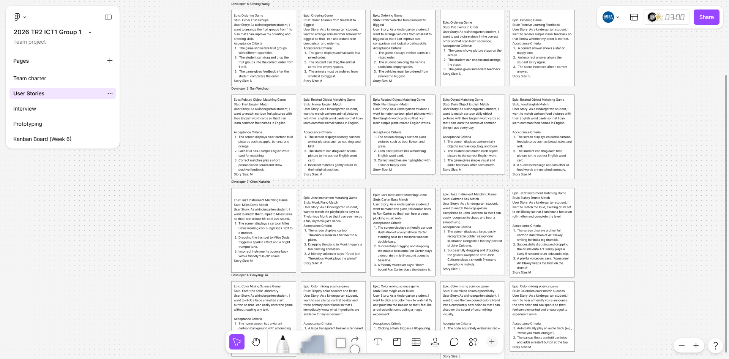
Design Rationale
User needs, constraints, decisions and trade-offs behind the final designs
User needs & constraints
Need-driven design
Main trade-off
• Young learners need clear wording, large images, and simple interaction
• KOPO limits pushed us to avoid complicated game mechanics
• Short sprint time required reusable layouts and fast revision cycles
Simple instructions
Visual examples
Clear feedback
Large touch areas
More features
vs
clearer learning flow
Decision: keep mechanics simple and improve engagement through themes.
Design decisions & trade-offs
helps children understand quickly
• Prioritised clarity over visual complexity
• Used familiar objects to reduce cognitive load
• Balanced fun, feedback, difficulty and feasibility
User stories and review notes shaped design decisions

Slide 5
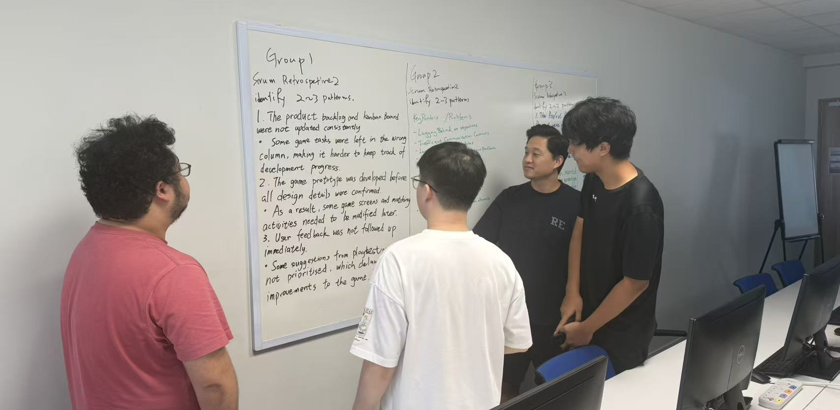
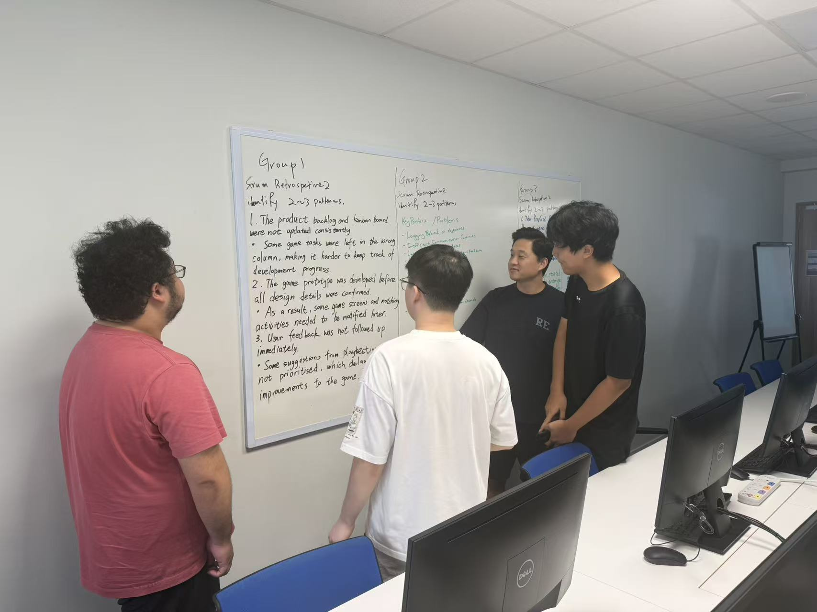
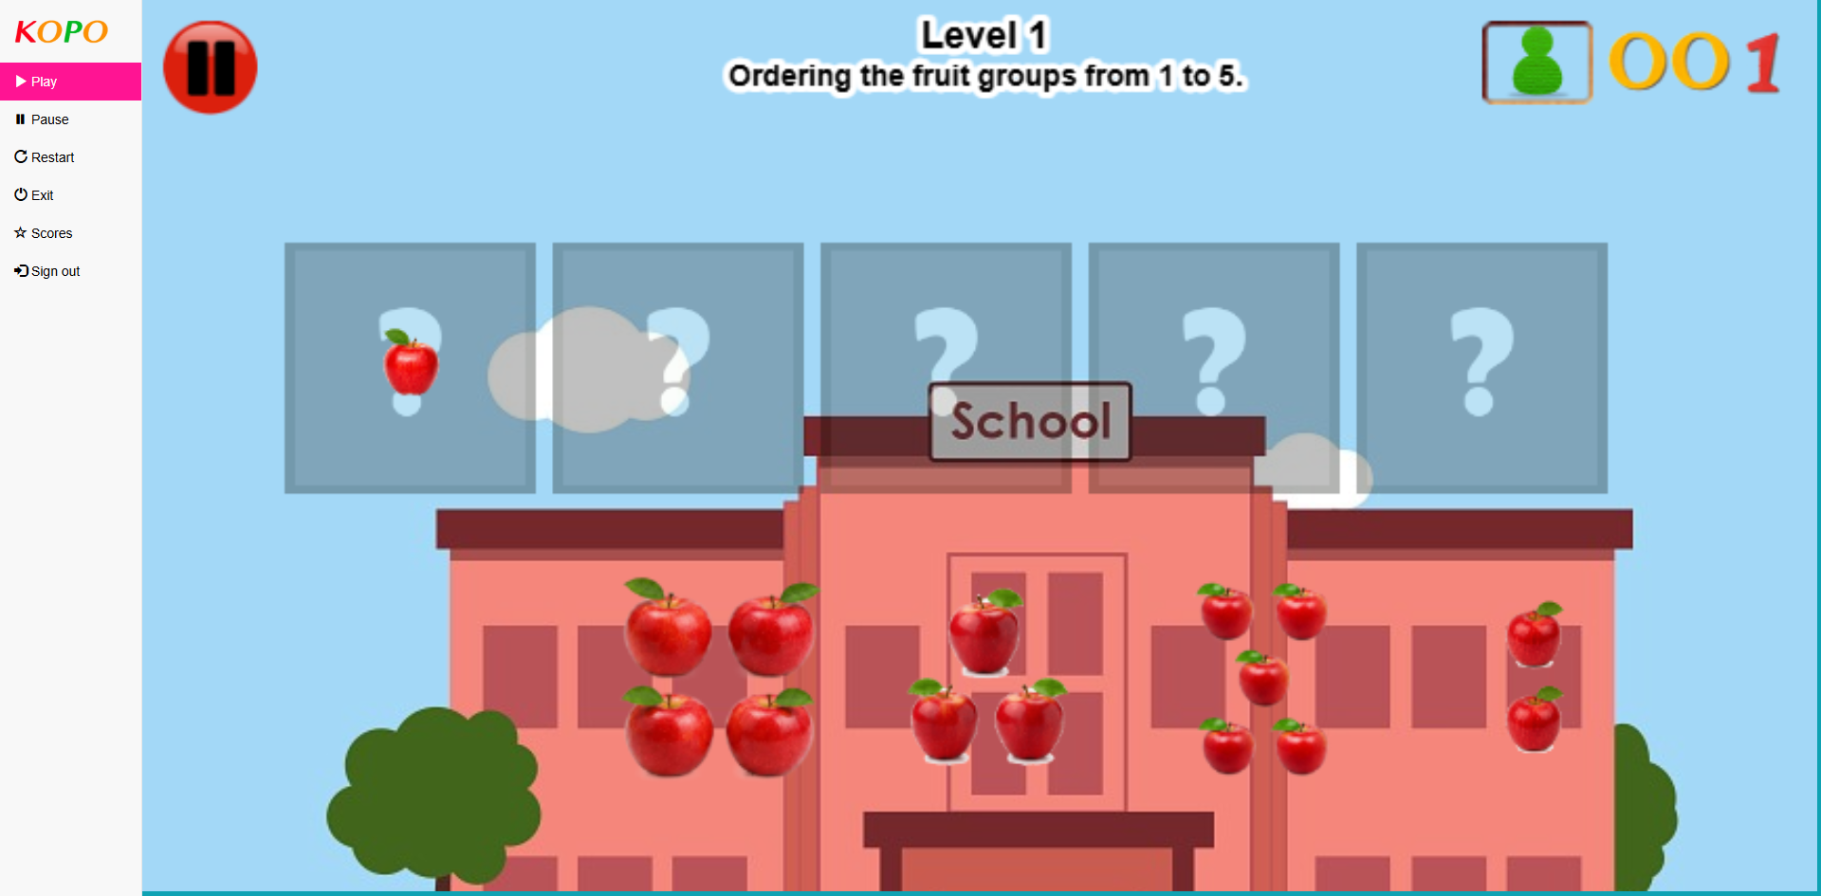
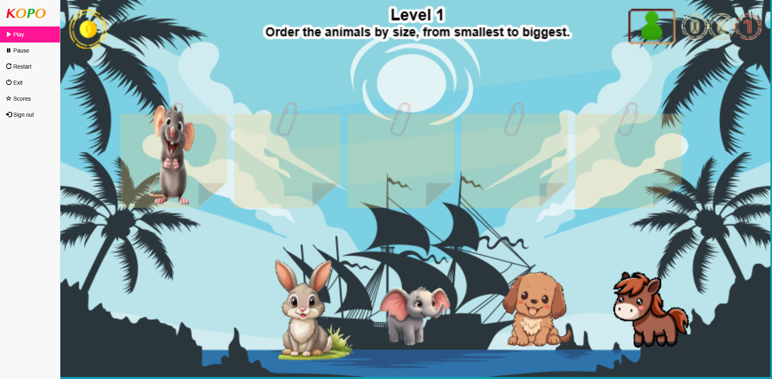
Design Evolution through Iterations: Sprint Pilot 1
Discovery, first ideas, and user-story-based design scope
• Collected user stories and assumptions for kindergarten learners
• Explored multiple game types: ordering, comparison, matching and sorting
• Defined scope around clear, feasible KOPO interactions
• Trade-off: many ideas vs focused learning outcomes
Team discussion
User story cards
Early fruit ordering / counting prototype
Early animal ordering prototype
Evidence used: user stories, prototype screenshots, review notes and FigJam records.

Slide 6
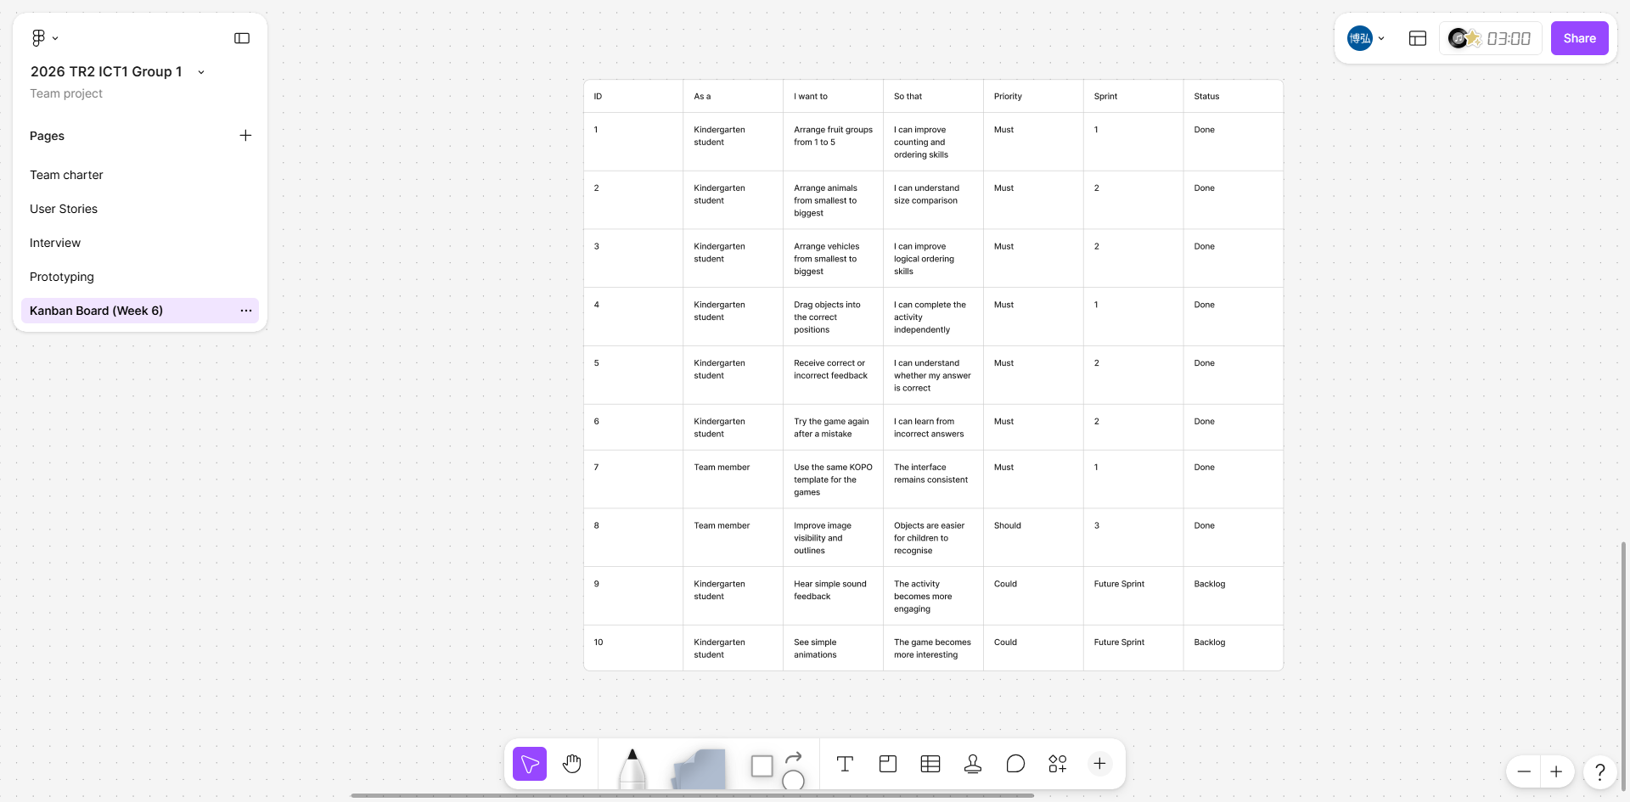
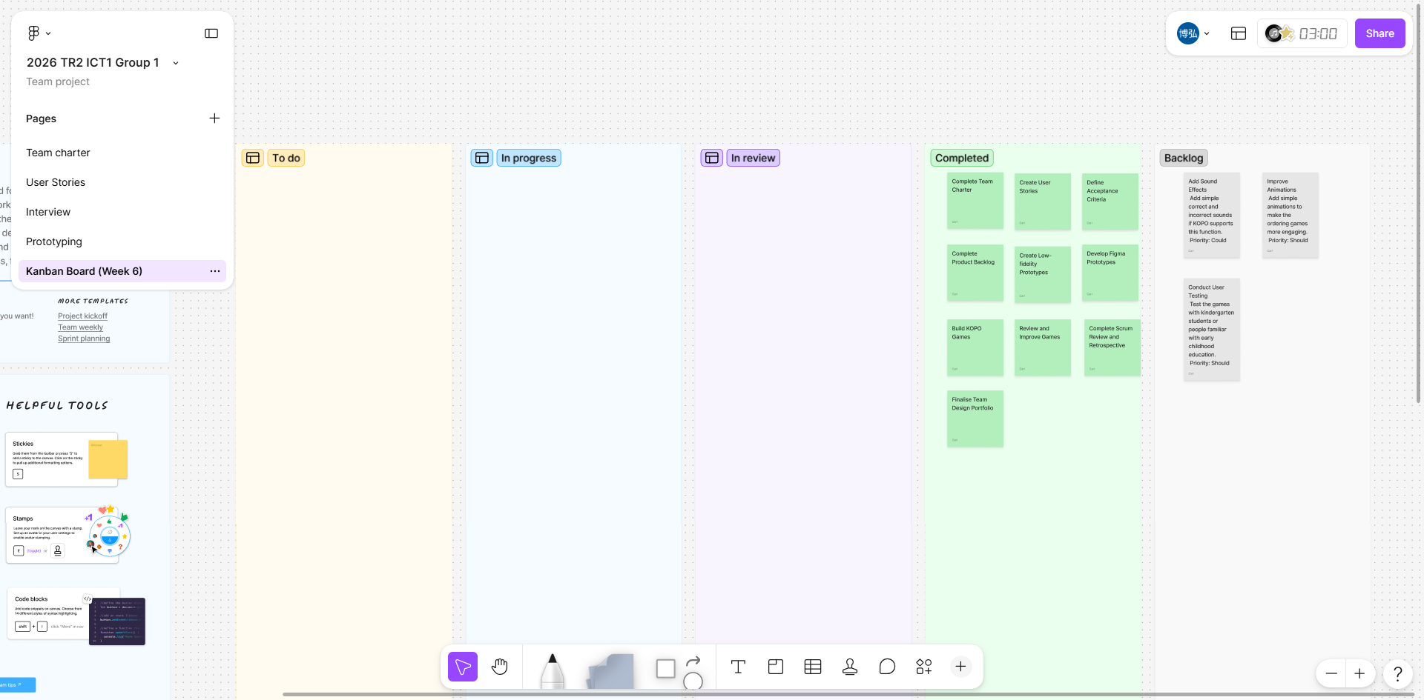
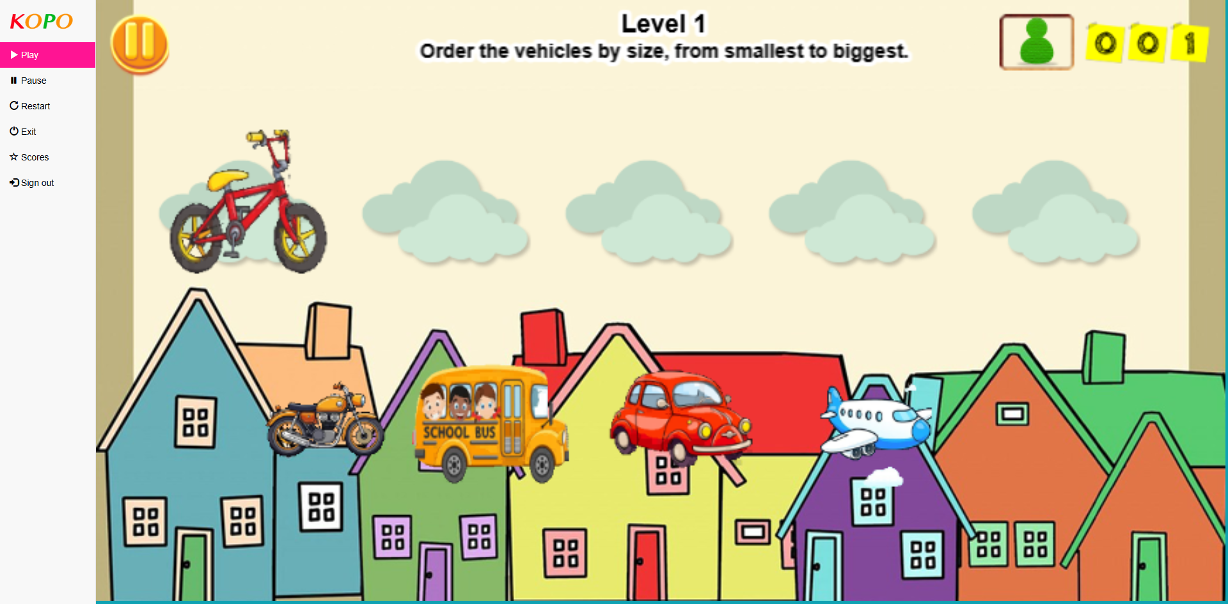
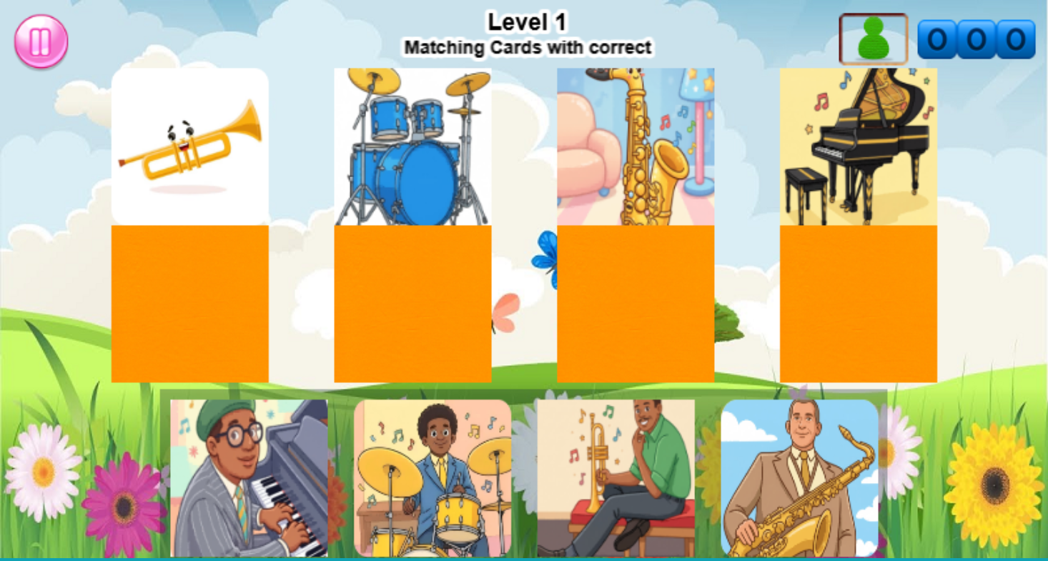
Design Evolution through Iterations: Sprint Pilot 2
Backlog organisation, sprint planning, and early prototype refinement
• Organised work with product backlog and Kanban board
• Assigned prototype tasks across four learning themes
• Compared screenshots to find layout and clarity issues
• Trade-off: planning detail vs implementation speed
Product backlog / task list
Kanban board
Early prototypes reviewed across levels
Main improvement direction: clearer instructions, consistent layout, larger images, and more obvious feedback.

Slide 7
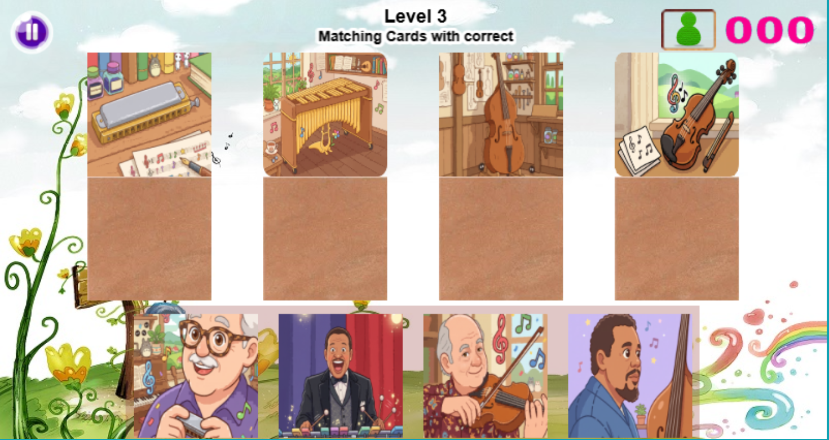
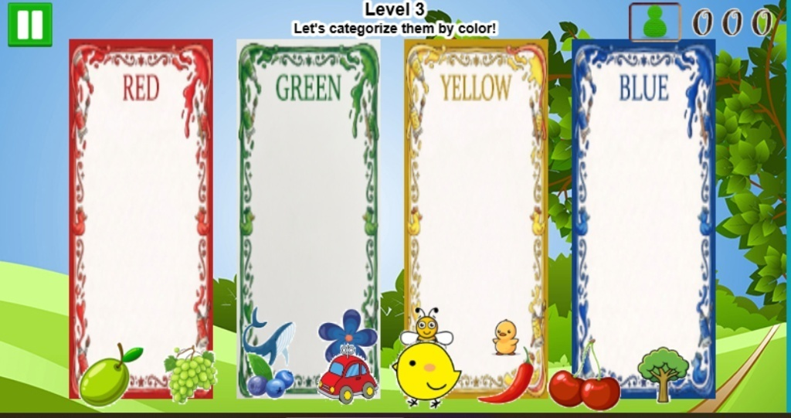
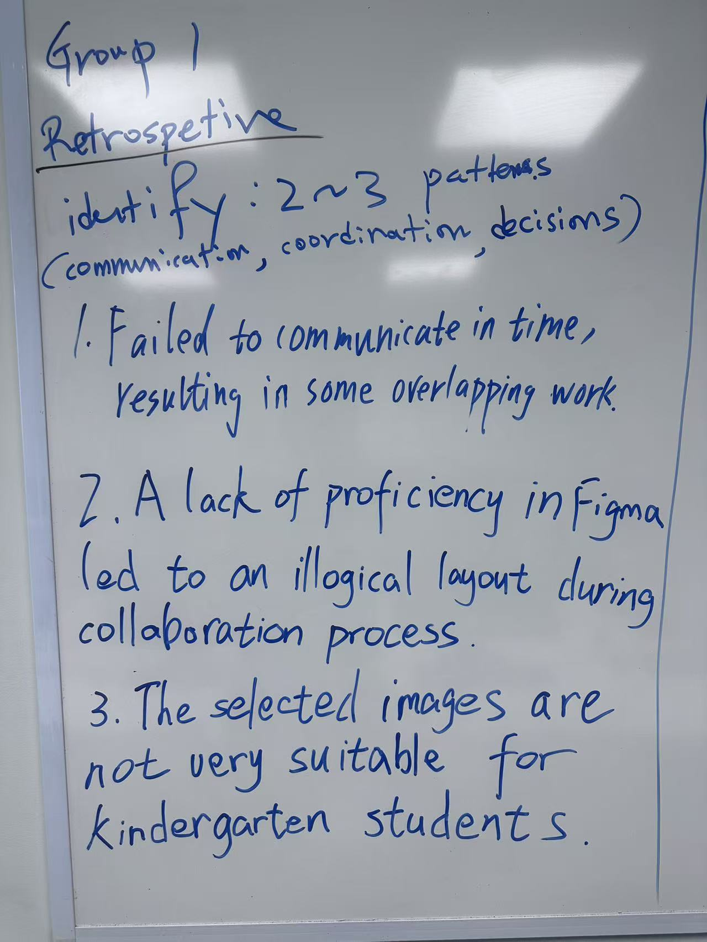
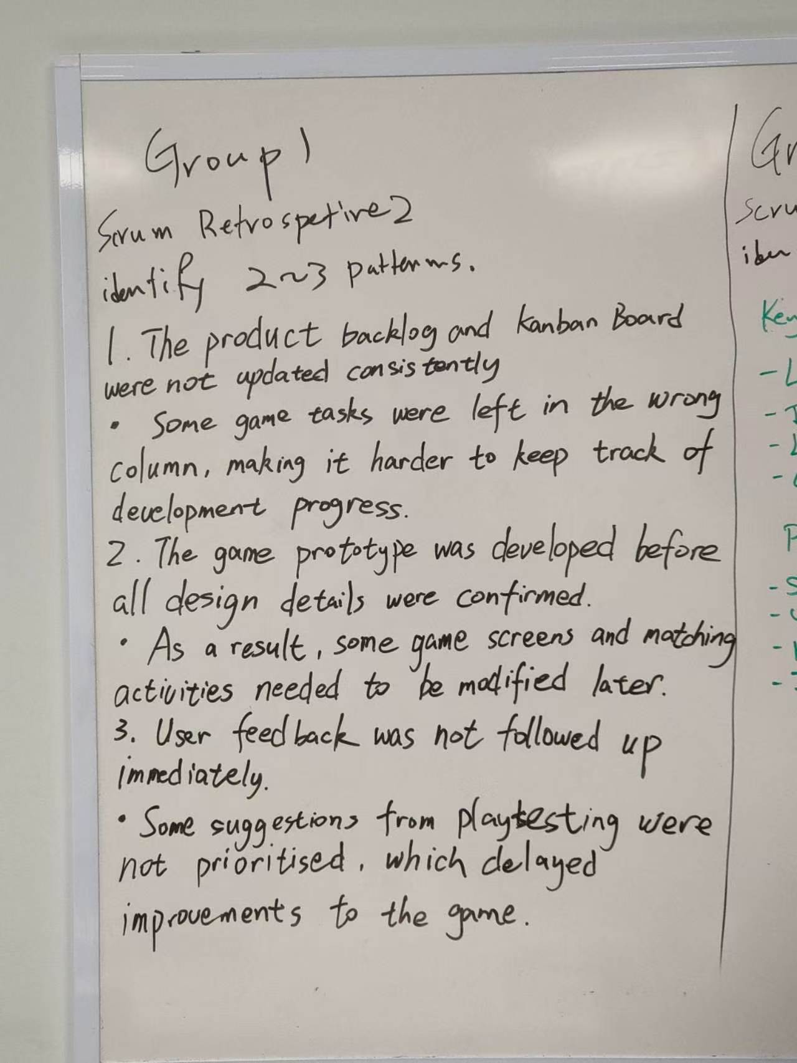
Design Evolution through Iterations: Sprint Pilot 3
Group prototype evidence and sprint retrospective notes after feedback
Sprint Pilot 3 focus
• Used review feedback to improve instructions and layouts
• Checked prototype evidence from all members
• Compared image clarity, touch areas and feedback
• Recorded retrospective issues for the next iteration
• Trade-off: final quality vs limited sprint time
Sprint retrospective evidence
Group prototype evidence
Retrospective 1: communication, layout, image suitability
Retrospective 2: backlog, Kanban, feedback follow-up
Review result: the sprint retrospective helped us identify communication gaps, backlog update issues, delayed feedback, layout problems, and image suitability improvements for the next iteration.

Slide 8
Conclusion
Main outcomes, teamwork reflection, and future improvements
• Delivered a portfolio of 12 child-friendly KOPO learning game prototype levels
• Used sprint pilots to check designs against user stories, feedback and acceptance criteria
• Improved question clarity, image visibility, touch areas, feedback and layout consistency
• Teamwork was collaborative; roles, FigJam, Kanban and reviews supported coordination
• Possible improvements:
- Clarify task ownership earlier in sprint planning
- Hold stronger retrospectives and more frequent check-ins to identify blockers earlier
Final message: simple, familiar and consistent design is the strongest approach for young learners.

